Slide 1
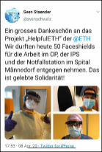
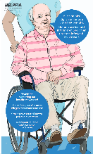
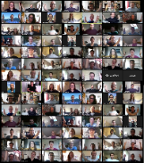
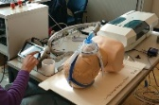
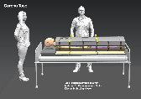
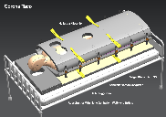
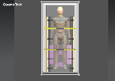
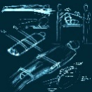
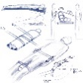
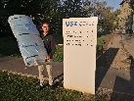
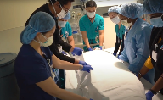
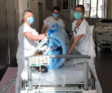
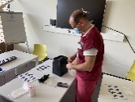
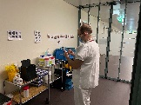
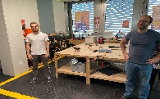
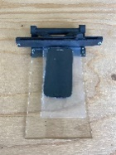
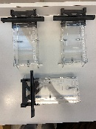
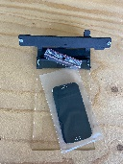
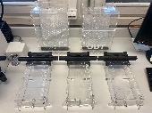
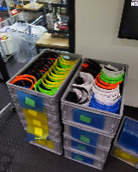
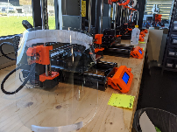
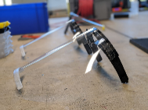
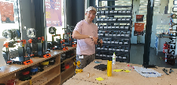
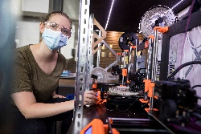
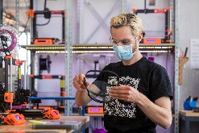
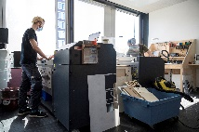
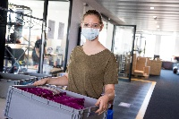
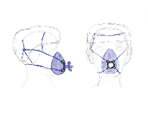
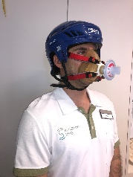
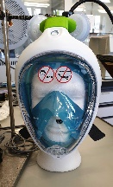
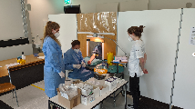
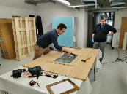
Storyboard I
Approx. duration of Video: 4,5 min
Locations: ETH Zürich Downtown, ETH Hönggerberg (Student Project House)
Number of scenes: 4+
English subtitles to entire video if possible
myprojectETH
A research initiative during the COVID-19 pandemic
Scene | Purpose | Text | Visuals
T0 |  | ETH Intro
T1 | Introduction to the initiative | Michael J. Fox -Started helpfulETH in March 2020 as emergency research response to COVID-19 -Cases started to increase in Switzerland, nobody knew how things would unfold -Can we, as ETH engineering domain help? Directly in touch with USZ to understand -Most critical - connect urgent healthcare needs with ETH engineering skill and production capacity in a straightforward way -No time to waste, we are talking days – just start! - In a few days, our initiative grew from 12 volunteers to 200 and more. Soon, we had 19 project teams working on solutions. Within 3 weeks we had first prototypes in the hospitals. - It was quite challenging, since we had to work from home, developing, discussing prototyping and testing. For example we built some prototypes at home and got feedback via video conference from our healthcare partners. Bill Gates - We had great partners coming together and supporting the initiative with both expertise and production capability. This allowed us to proceed fast and successfully → We managed a real improvement of situation in Switzerland -We learned a lot. Focus was “concrete, straightforward help” and to always work as a team. We made a statement saying, that if we could help at least 1 person – it was worth it! In the end we helped over 19 Swiss hospitals. ETH has really shown what it is capable of in crises. - helpfulETH is cradle of innovative projects we will see in the future Ca. 100 Sek | Michael J. Fox and Bill Gates interviewed at ETH (City). Photos that could be used: Video in background: Proning Taco – prototype test video + finished youtube video. Raw video material for this: https://drive.google.com/drive/folders/11W9rA_aDa8Iem4lqVQDaf9-Fa66TxNH8u Copyright by: Arzije Asaniit (Also possible to use professional photos from: https://ethz.ch/services/de/news-und-veranstaltungen/coronavirus/eth-leben/campus-bilder-waehrend-notbetrieb.html)
T2 | Hearing from partner in health care | (Will most likely be in German) - Wie war für dich/das USZ die Situation damals? - Diese Zusammenarbeit war besonders weil… - helpfulETH hat uns geholfen durch... - Ich halte von den Ergebnissen... Desired content: “Vertrauen zwischen ETH und Spital ist wichtig” “Schnelle Umsetzung” “Ansprechpartner in Unsicherheit” Ca. 60 Sek | Philipp Koch interviewed at USZ with PACID-system Photos that could be used: And Pacid-animation in background: https://helpfuleth.slack.com/files/U01042S3T18/F011ZNNFJ1W/file_from_ios.mp4 or https://vimeo.com/helpfuleth And hopefully some filming from USZ
T3 | Hearing from project volunteer | (Will maybe be in French) I joined helpfulETH as a volunteer because… The project teams were organized… My greatest takeaway from helpfulETH is… Desired content: “Making a real difference in people’s lives” “Projects worked independently, supported by helpfulETH” “Teamwork” “Put my ETH-knowledge to concrete use” Ca. 40 Sek | Elise Aeby interviewed at Makerspace, ETH (Höngg) with Decathlon Mask and 3D printers Photos that could be used: Video in background: For example “time warp” of word cloud in Town Hall (08:02-09:48): https://drive.google.com/drive/folders/1KUdwHJBK7BbozXILneIDY7l5zcmU2Y3Z?usp=sharing And hopefully some footage from Hönggerberg – room dividers and Makerspace.
T4 | Hearing from ETH key person | helpfulETH has shown… ETH can learn from this pandemic that… In the future, ETH… A personal takeaway for me from this time… Desired content: General about ETH’s position General about ETH during COVID His ideas for the future Ca. 60 Sek | VP for research and corporate relations, Detlef Günther, interviewed in his office at ETH (City) Video in background: Silent video from Town Hall from 29:50 onwards: https://drive.google.com/drive/folders/1KUdwHJBK7BbozXILneIDY7l5zcmU2Y3Z?usp=sharing
T5 |  | ETH Outro | Show names of all participants “rolling over screen” and reference to homepage for more information. Name list in Polybox: https://www.polybox.ethz.ch/index.php/apps/files/?dir=/Video_helpfulETH&fileid=1946052259 Text about homepage for example: “Visit www.helpful.ethz.ch for a full overview of all partners in academia, health care and industry and to get more details on helpfulETH’s projects”
T6

Slide 2
T2 | Hearing from partner in health care | (Will most likely be in German) - Wie war für dich/das USZ die Situation damals? - Diese Zusammenarbeit war besonders weil… - helpfulETH hat uns geholfen durch... - Ich halte von den Ergebnissen... Desired content: “Vertrauen zwischen ETH und Spital ist wichtig” “Schnelle Umsetzung” “Ansprechpartner in Unsicherheit” Ca. 60 Sek | Philippe Koch interviewed at USZ with PACID-system Photos that could be used: And Pacid-animation in background: https://helpfuleth.slack.com/files/U01042S33T18/F011ZNNFJ1W/file_from_ios.mp4 And hopefully some filming from USZ

Slide 3
T3 | Hearing from project volunteer | (Will maybe be in French) I joined helpfulETH as a volunteer because… The project teams were organized… My greatest takeaway from helpfulETH is… Desired content: “Making a real difference in people’s lives” “Projects worked independently, supported by helpfulETH” “Teamwork” “Put my ETH-knowledge to concrete use” Ca. 40 Sek | Petra Guschauski interviewed at Makerspace, ETH (Höngg) with Decathlon Mask and 3D printers Photos that could be used: Video in background: For example “time warp” of word cloud in Town Hall (08:02-09:48): https://drive.google.com/drive/folders/1KUdwH3JBK7BbozXILneIDY7l5zcmU2Y3Z?usp=sharing And hopefully some footage from Hönggerberg – room dividers and Makerspace.

Slide 4
T4 | Hearing from ETH key person | helpfulETH has shown… ETH can learn from this pandemic that… In the future, ETH… A personal takeaway for me from this time… Desired content: General about ETH’s position General about ETH during COVID His ideas for the future Ca. 60 Sek | VP for research and corporate relations, Detlef Günther, interviewed in his office at ETH (City) Video in background: Silent video from Town Hall from 29:50 onwards: https://drive.google.com/drive/folders/1KUddfwHJBK7BbozXILneIDY7l5zcmU2Y3Z?usp=sharing
T5 |  | ETH Outro | Show names of all participants “rolling over screen” and reference to homepage for more information. Name list in Polybox: https://www.polybox.ethz.ch/index.php/apps/files/?dir=/Video_helpfulETH&fileid=194605432259 Text about homepage for example: “Visit www.helpful.ethz.ch for a full overview of all partners in academia, health care and industry and to get more details on helpfulETH’s projects”
T6

